Slide 1



Slide 2
Summer Internship Program
HIRING -HACKATHON 2019
BY
SURYA ABHIRAM

Slide 3



PROBLEM STATEMENT
Predictive Analysis in Agriculture to Improve the Crop Productivity......

Slide 4
INTRODUCTION:
Agriculture is believed to be as backbone of indian
economic system.For the past few decades agriciulture
field has seen a lot of technological changes to improve better productivity.The world population grows steadily
but the resources for crop production continously
diminish.

Slide 5
PREDICTIVE ANALYSIS AND ITS BENEFITS :
Precision agriculture follows recognizing the previous
year yield values,understanding the current requirement of environment and exploiting information that quantifies variations in soil and crop within agricultural fields.
The precise crop variety selection,exact type of
fertilizers,proper irrigation meet the demand of crops
for optimum growth and development
It may lead to increase the yield,especially in main
areas

Slide 6
EXPLORATORY DATA ANALYSIS
Need to check for missing or null values.
Understanding the data to implement the required
model type on the basis of the outcome or output
value.
1.)CLASSIFICATION MODEL
2.)REGRESSION MODEL
Analysis of data and deciding the independent and
dependent variables.
Use necessary techniques to determine the outcome with good efficiency and plot visualisations if any.

Slide 7
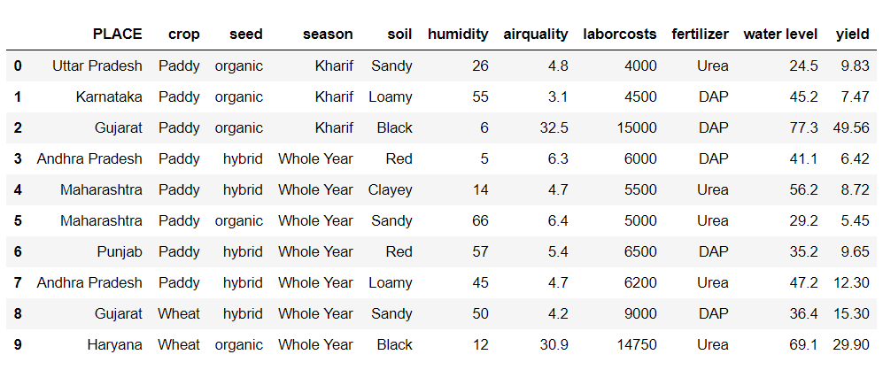
SAMPLE OF DATA

Slide 8
Factors effecting the Crop productivity
From the data, we can observe the factors on which the crop productivity i.e., Yield is dependent are :-
TYPE OF SEED.
TYPE OF SEASON.
TYPE OF SOIL.
HUMIDITY.
AIR QUALITY.
LABOUR COST.
TYPE OF FERTILIZERS.
WATER LEVEL.
These factors are responsible for change in the Yield of
crop so these are called independent variables and the
outcome i.e., Yield is the dependent variable

Slide 9
METHOD OF APPROACH
The first step for any data analysis is Importing the libraries which are
required for the program.
Then we need to import our data set to the program and split the data set into independent(X-variables) and dependent(Y-variables).
Splitting the data into Train and Test is one of the key step to train the
model to gain perfect accuracy.
Choosing the type of model based on the data,here it is a regression model and I choosed Multi-variable linear regression.
Fitting the model with train values predicting the result with test values.
Observing the accuracy between predicted and actual values and
based on it deciding the choice of model

Slide 10
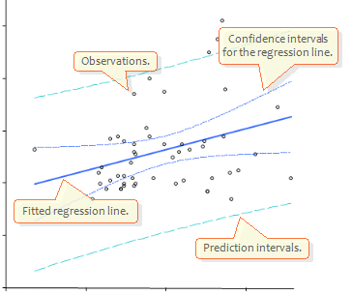
Multiple linear regression (MLR), also known simply as multiple regression, is a statistical technique that uses several explanatory variables to predict the outcome of a response variable. The goal of multiple linear regression (MLR) is to model the linear relationship between the explanatory (independent) variables and response (dependent) variable.

Slide 11
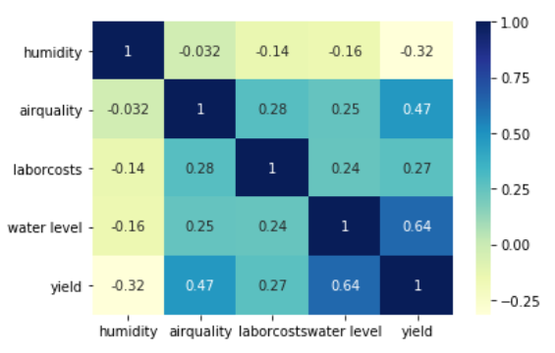
VISUALISATION OF THE DATA
CORRELATION BETWEEN COLUMNS

Slide 12
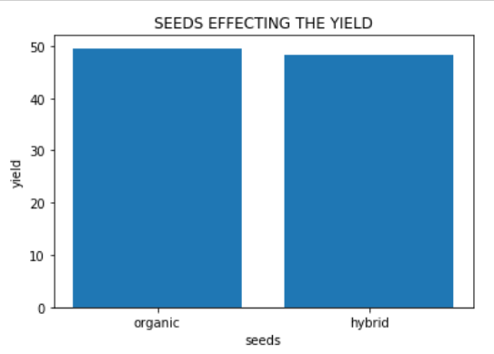
RELATION BETWEEN INDEPENDENT AND DEPENDENT VARIABLES
Type of seeds effecting the yield

Slide 13
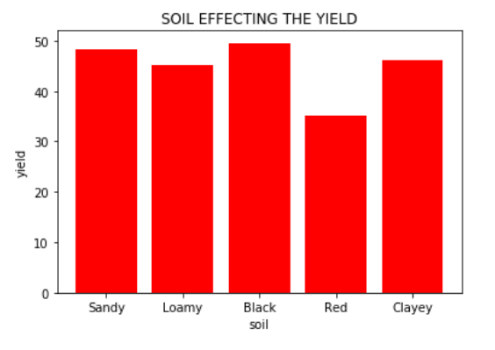
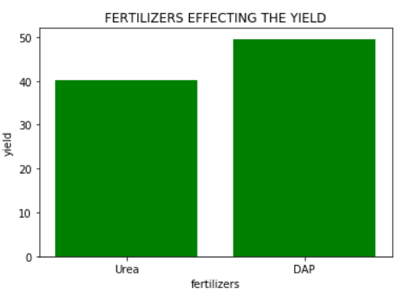
Type of soil effecting the yield
Type of fertilizer effecting the yield

Slide 14
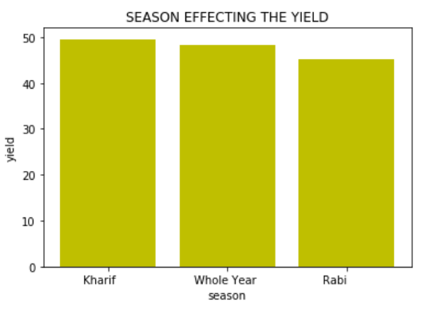
Type of season effecting the yield

Slide 15
USER INTERFACE
The means by which the User and the computer system
interact,in particular the use of input devices and
software.
By deploying the code into the Watson Studio in IBM
cloud we can generate a scoring uid.
To generate a Flow we use NODE-RED flow editor.
NODE-RED is a flow based development tool for visual programming developed by IBM for wiring together
hardware devices,APIs and Online services

Slide 16
CONCLUSION
Predictive analysis in agriculture is crop yield monitoring concept. Implementation of this concept should help farmer to produce higher yield. System can find required amount of land, water, fertilizer, pesticides to maximize the crop product. So that farmers obtain a return on their investment by saving on fertilizer cost. Another benefit of this concept is adjusting with environmental factors.
Accuracy of the model : 0.8252

Slide 17
THANK YOU

